Slide 1


Transfer Learning

Slide 2

Transfer Learning Methods
Instance Transfer
Reweight instances of target data according to source
Feature Transfer
Mapping features of source and target data in a common space
Parameter Transfer
Learn target model parameters according to source model

Slide 3
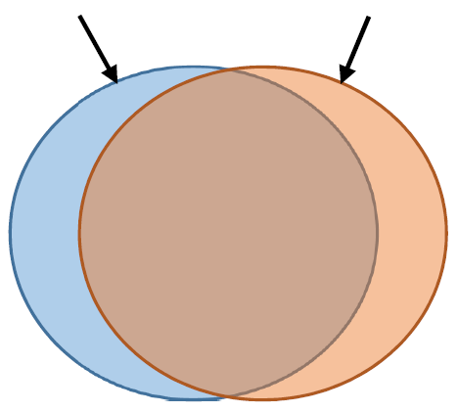


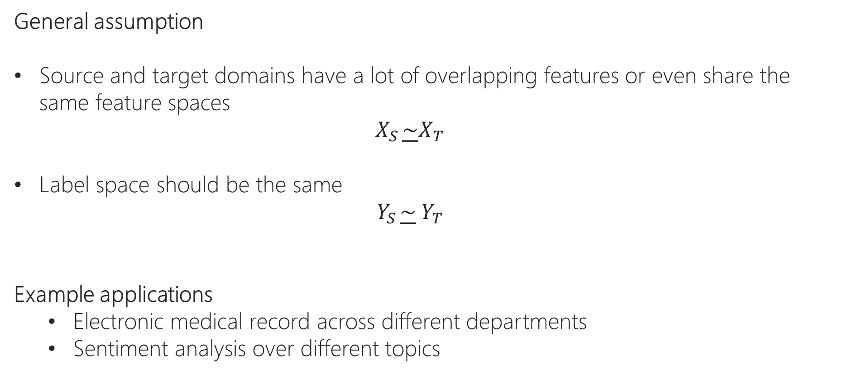
Instance-based Transfer Learning
General assumption
Source and target domains have a lot of overlapping features or even share the same feature spaces
$$X_{S }\underline{\sim }X_{T}$$
Label space should be the same
$$Y_{S }\underline{\sim }{ Y}_{T}$$
Example applications
Electronic medical record across different departments
Sentiment analysis over different topics
$$X_{S }$$
$$X_{T }$$

Slide 4
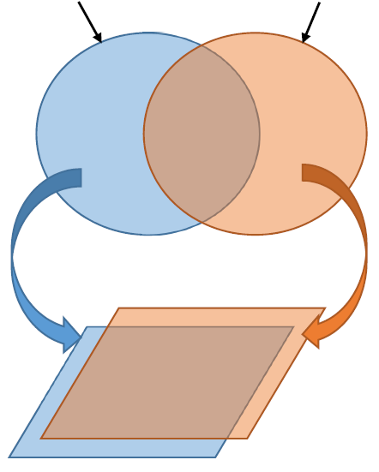
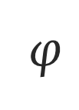
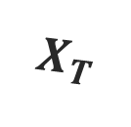

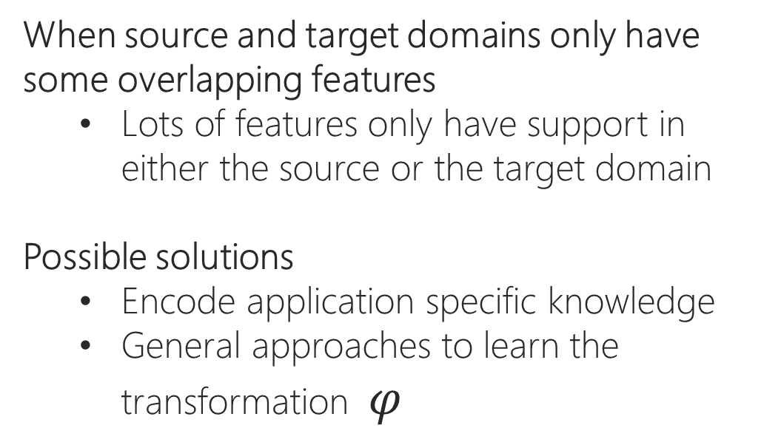

Feature-based Transfer Learning
When source and target domains only have some overlapping features
Lots of features only have support in either the source or the target domain
Possible solutions
Encode application specific knowledge
General approaches to learn the transformation $φ$
$$X_{S }$$
$$X_{T }$$
$$φ$$
$$φ$$

Slide 5
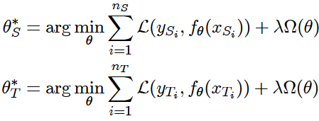



Parameter-based Transfer Learning
The $θ$- parameterized function $f_{θ}\left(X\right)$ learned on two domains
Motivation
A well-trained model has learned a lot of structure on the source domain
If two tasks are related, this structure can be transferred to learn the model on the target domain

Slide 6
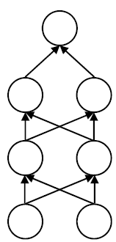
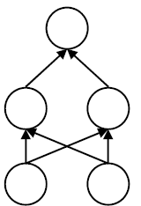
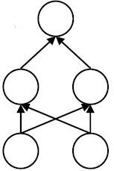
Transfer Learning in Deep Learning
Feed new data for domain adaptation
Build higher layers for training another task (feature transfer)
Target task
Source task
Target task
Feature
representation
Feature
representation
Feature
representation
Source Data
Target Data
Target Data

Slide 7
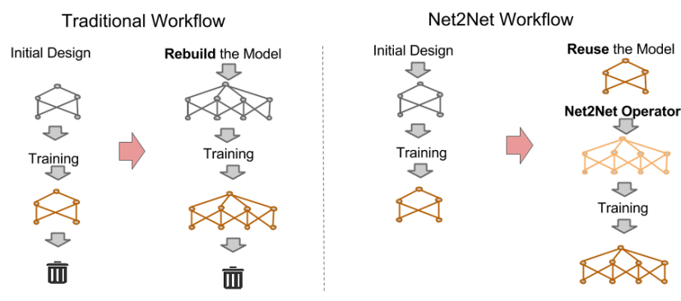
Net2Net Transfer
Net2Net reuses information of already trained model to speedup training of new model

Slide 8
Transfer Learning in Deep Learning
Why use a pre-trained model?
It’s faster (it’s pre-trained)
It’s cheaper (no need for GPU farm)
It generalizes (avoid overfitting)

Slide 9
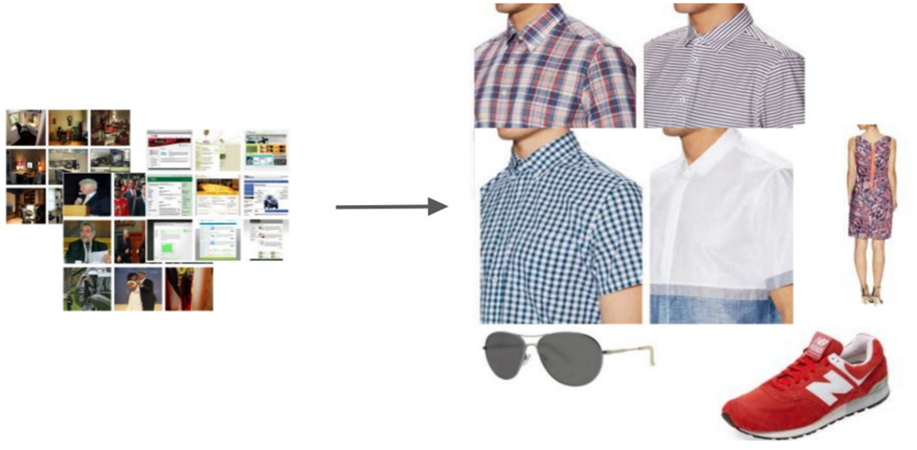
Transfer Learning

Slide 10
Transfer Learning Strategies in Deep Learning

Slide 11
Transfer Learning in Deep Learning
ConvNet as fixed feature extractor
Example: Use a car classifier to further classify the car brand
Very fast
Fine-tuning the ConvNet
Fine-tune weights of pre-trained CNN
Fine-tune all layers / Keep early layers fixed and fine-tune remaining layers
Slow

Slide 12
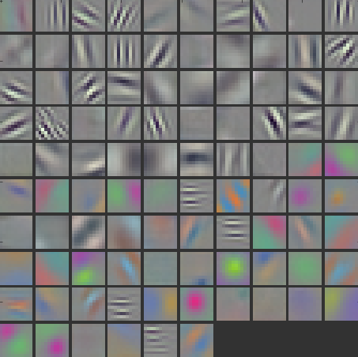
Generic to Specific
generic
Lion
specific
Layers
Notes:
At the beginning layers, we learn features that are general. At the last layers, we learn features that are specific to the target task. The question is how this transition occurs. We quantify the transition using transfer learning.

Slide 13
Fine-tuning
Defining transfer learning
How it works
Frozen weights
Fine tuning
Selffer
Fine tuner
Transfer
Figure for demonstrating how backprop woks
Input A
Task A
Layer n
Transfer
Input B
Task B

Slide 14
When To Use Transfer Learning?
Dependence on size of the new dataset and similarity to the original dataset
Features are more generic in early layers and more dataset-specific in later layers
4 Scenarios
 | Relatively Smaller | Relatively Large
Similar | Similar higher-level features Train classifier on CNN features | - Fine-tune
Different | - Train classifier from activations somewhere early in the network | - Train from scratch

Slide 15
Constraints and Learning Rates
Assume that the weights from pre-trained CNN are robust
To avoid distortion too quickly or too much, keep the learning rate and learning rate decay small

